Slide 1
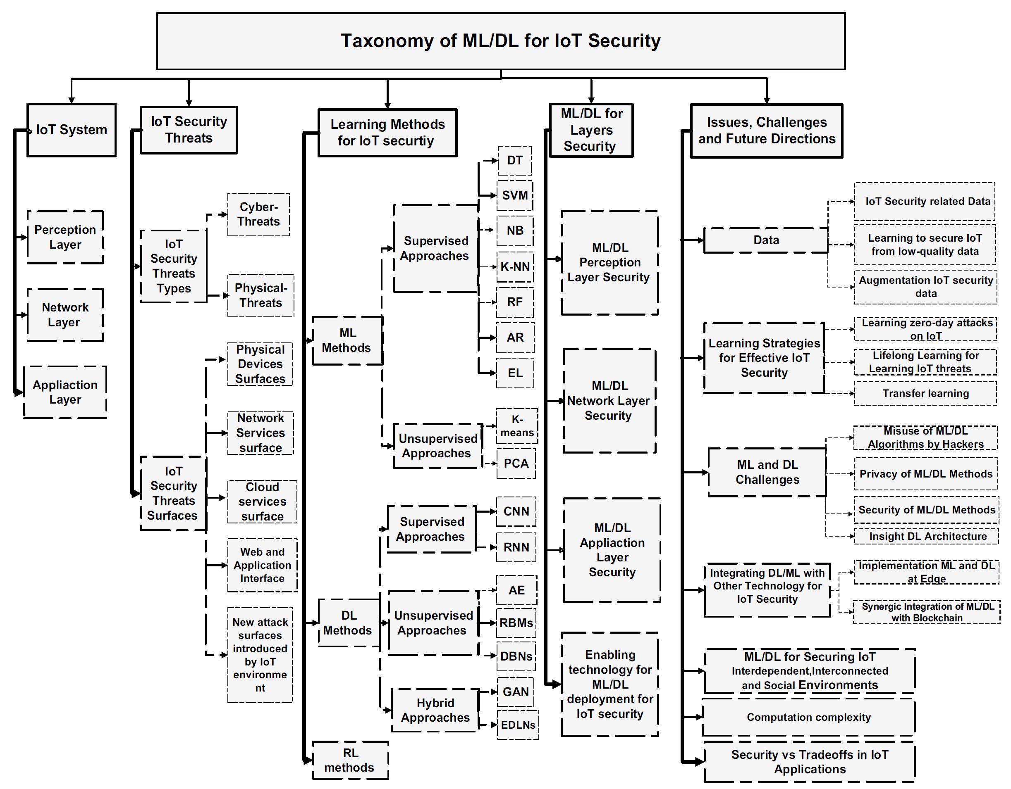

Slide 2
Taxonomy of ML/DL for IoT Security
IoT System
Learning Methods for IoT security
ML/ DL for Layers Security
IoT Security Threats
Issues, Challenges and Future Directions
Perception Layer
Network Layer
Application Layer
IoT Security Threat Types
Cyber threats
Physical threats
IoT Security Threats Surfaces
Physical Devices Surfaces
Network Services Surface
Cloud Services Surface
Web and Application Interface
New attack surfaces introduced by IoT environment
ML methods
DL methods
RL methods
Supervised approaches
DT
SVM
NB
K-NN
RF
AR
EL
Unsupervised approaches
K-means
PCA
Supervised approaches
CNN
RNN
Unsupervised approaches
AE
RBMs
DBNs
Hybrid Approaches
GAN
EDLNs
ML/DL Perception Layer Security
ML/ DL Network layer security
ML/ DL Application layer security
Enabling technology for ML/ DL deployment for IoT security
Data
Learning Strategies for Effective IoT Security
ML and DL Challenges
Integrating DL/ML with Other Technology for IoT Security
ML/DL for Securing IoT Interdependent, Interconnected and Social Environments
Computation complexity
Security vs Tradeoffs in IoT Applications
IoT security related data
Learning to secure IoT from low quality data
Augmentation IoT security data
Learning zero day attacks on IoT
Lifelong learning for learning IoT threats
Transfer learning
Misuse of ML/ DL algorithms by hackers
Privacy of ML/ DL methods
Security of ML/ DL methods
Insight DL architecture
Implementation ML and DL at Edge
Synergic Integration of ML/DL with Blockchain

